Slide 1

GALGOTIAS UNIVERSITY
Project-II
PRESENTATION ON
“SMART VEHICLE PARKING SYSTEM”
Semester: IV
Presented By:
Bibek Jha (20SCSE1010849)
Mohd. Sabeel Aijaz (20SCSE1010852)
Ankit Kumar (20SCSE1300006)
Submitted To:
MS. N. Suvarna

Slide 2
School of Computing Science & Engineering
Course Name :Project-1
Objectives:
Abstract
Introduction
Related Review
Problem Formulation
Tools and Technology
Conclusion
Program Name: B-TECH CSE Sem: III

Slide 3
School of Computing Science & Engineering
Course Name :Project-2
SMART VEHICLE PARKING SYSTEM
ABSTRACT
One of the most annoying things happening in our era is looking for a parking spot and not being able to find one, especially when you had to be somewhere five minutes ago and you are currently looking for a parking spot for 20 minutes now. It is due to the proliferation in the number of vehicles on the road; traffic problems are bound to exist. Another reason is due to the fact that current transportation infrastructure and car park facility developed are unable to cope with the influx of vehicles on the road.
However, any problem must have a solution, or more solutions, based on complexity and efficiency. There are many solutions for smart parking systems out there, including deep learning implementations, weight sensors, light sensors and all of that science fiction stuff that surrounds the world these days. To alleviate the aforementioned problems, the smart parking system has been developed. With the implementation of the smart parking system, patrons can easily locate and secure a vacant parking space at any car park deemed convenient to them.
This project is focusing trough one of the finest approaches to a smart parking system using only a webcam and few lines of code. The concept behind this solution is quite simple. The proposed system illustrates the counter for number of parking spaces, the cars entering the parking area and also shows the number of vehicles that is already parked in parking area. The future of the smart parking market is expected to be significantly influenced by the arrival of automated vehicles (AVs). Several cities around the world are already beginning to trial self-parking vehicles, specialized AV parking lots, and robotic parking valets.
Program Name: B-TECH CSE Sem: IV

Slide 4
School of Computing Science & Engineering
Course Name :Project-2
CHAPTER-1
Introduction
1.1 Introduction
In recent times, household vehicles have increased rapidly with population growth and economic development. Meanwhile, spaces required to park these cars in public places has rather been in short supply and are becoming very costly too. This rising imbalance is very evident in major attraction areas that witness the influx of large numbers of people visiting in motor vehicles. Finding parking spaces in such places during events is challenging. Vehicle owners often undergo the extremely frustrating process of driving through the entire area in an unguaranteed search of available parking spots. Productive working hours are lost, fuel is expended, and carbon emissions from conventional engine vehicles increases.
OpenCV
OpenCV (Open-Source Computer vision) is permitted for both scholastic and commercial use. It is a library of programming functions mainly aimed at real-time computer vision. OpenCV's application has wide areas which includes 2D and 3D feature toolkits, Ego motion estimation, Facial recognition system, Gesture recognition, Motion understanding, Object identification Segmentation and recognition and Motion tracking.
Program Name: B-TECH CSE Sem: IV

Slide 5
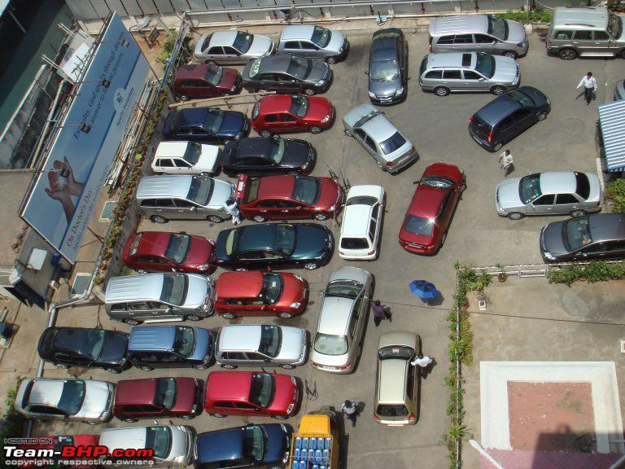
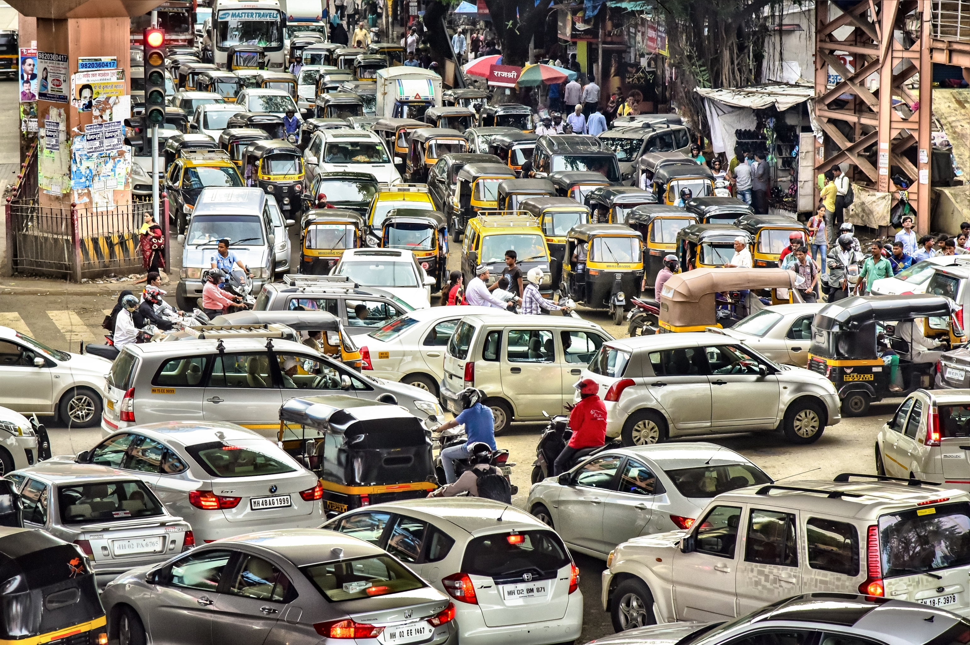
School of Computing Science & Engineering
Course Name :Project-2
Problem Formulation
One of the most annoying things happening in our era is looking for a parking spot and not being able to find one, especially when you had to be somewhere five minutes ago and you are currently looking for a parking spot for 20 minutes now. It is due to the proliferation in the number of vehicles on the road; traffic problems are bound to exist. Another reason is due to the fact that current transportation infrastructure and car park facility developed are unable to cope with the influx of vehicles on the road.
Program Name: B-TECH CSE Sem: IV

Slide 6
School of Computing Science & Engineering
Course Name :Project-2
Solution regarding this project:
However, any problem must have a solution, or more solutions, based on complexity and efficiency. There are many solutions for smart parking systems out there, including deep learning implementations, weight sensors, light sensors and all of that science fiction stuff that surrounds the world these days. To alleviate the aforementioned problems, the smart parking system has been developed. With the implementation of the smart parking system, patrons can easily locate and secure a vacant parking space at any car park deemed convenient to them. With vehicle detection sensors aplenty on the market, the choices made may defer due to the different requirements in addition to the its pros and cons.
This project is focusing trough one of the finest approaches to a smart parking system using only a webcam and few lines of code. The concept behind this solution is quite simple. It is composed of two scripts with the following roles: Select the coordinates of the parking spaces and save them into a file and get the coordinates from the file and decide if the spot is available or not. The reason for splitting this solution in two scripts is strictly related to avoiding to select the spots every time you want to see if there are any available spots especially if used the same location a use before.
Program Name: B-TECH CSE Sem: IV

Slide 7
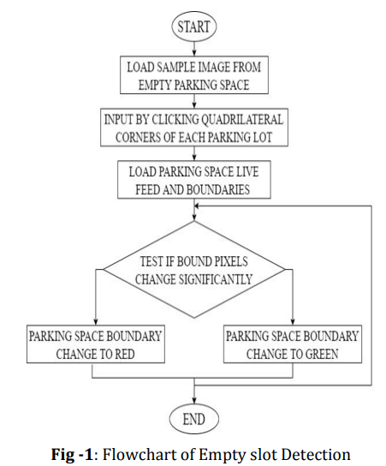
School of Computing Science & Engineering
Course Name :Project-2
ALGORITHM
We have used two algorithms to build the application of Smart Parking System.
OpenCV
The still image file is a frame of the video file and after the code is executed, the still image shows and with the mouse, a quadrilateral would be constructed from its three input points. Coordinates of the input points are stored in a YAML file and then the letter ‘q’ shall be pressed to initialize the display of the video feed. The quadrilaterals created to zone each parking slot are outlined either red or green. Red means that the computer recognizes the parking space within the quadrilateral as occupied by a car and green means it is available for parking.
Program Name: B-TECH CSE Sem: IV

Slide 8
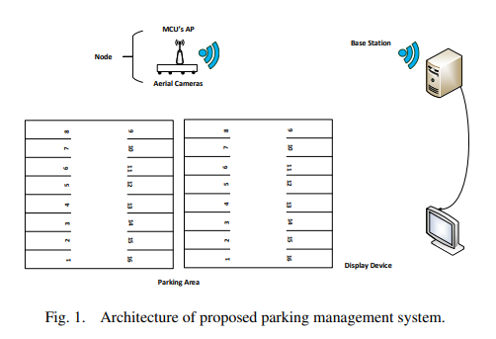
School of Computing Science & Engineering
Course Name :Project-2
Architecture of System
The smart parking system proposed in this paper consists of three main components.
These are the parking detection nodes with incorporated Wi-Fi access points (APs) deployed within each
major section of the parking facility, a wireless local area network (WLAN) integrated local base station, and a
notification system for information delivery. The architecture of the proposed system is shown in Figure 1.
Program Name: B-TECH CSE Sem: IV

Slide 9
School of Computing Science & Engineering
Course Name :Project-2
CHAPTER-2 Literature Survey
Ming-Yee Chiu et al. proposed a method for counting the vehicles at the checkpoint from which the number of available parking spaces can be counted [1]. The counting is performed by installation of the induction loop sensors under the road surface. Although the usage of sensors was less costly, not easily affected by environmental conditions and it detects accurately however, it installation was difficult and cause damage to roads. It was also difficult to maintain it in case of malfunction [2]. Image processing is a hot research subject for quite a while and has scope for some developments in innovative applications. Image processing is required in all the major developing and advanced sectors of society like medical, security, engineering, entertainment, media and much more. Distinctive image pre-processing strategies important to accomplish higher exactness utilizing techniques like RGB to grey, blurring, thresholding and contouring [3] is significant. In certain areas enormous number of pictures are required to get to certain data. The Histogram method is executed to get statistical data from a image and categorize the image as poor or good [4]. It is likewise utilized for the normalization and equalizing the image. For mall, redundant or unwanted fragments in a image a two phase outline work of Histogram handling for separating and choice to expel undesirable little messages from a picture is utilized [5]. In License Plate Detection the text extraction is the significant objective in this way image processing turns into the most essential part preceding image to text conversion. The methodology in [6] uses the strategy for corner focuses for text extraction in document images. It has fixed parameters appointed for various kinds of pictures like handwritten, typewritten, skewed, etc. and it is very quick. Paper [7] proposes the strategy for detecting license plate in an image taken from varied distances and different illuminations utilizing wavelet change and masking out potential license part. After the processing is finished then the processed image can be given to the Tesseract OCR Machine to change over the image into text utilizing command line interface [8].
Program Name: B-TECH CSE Sem: IV

Slide 10
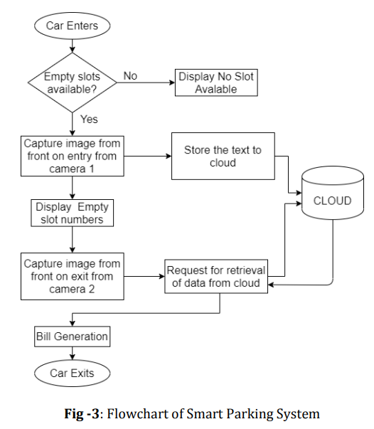
School of Computing Science & Engineering
Course Name :Project-2
Chapter-3
Methodology and Implementation:
A car enters the parking lot and the parking lot is checked for empty slots. If there exists any then the number plate
of the car is scanned using the first camera and stored in cloud and let into the parking lot by displaying the slots available. If there are no empty slots available,
then the same will be displayed. When the car exits then the number plate is scanned again using the second camera and compared with the time of its arrival. A bill is
generated based on time of stay of the vehicle
Program Name: B-TECH CSE Sem: IV

Slide 11
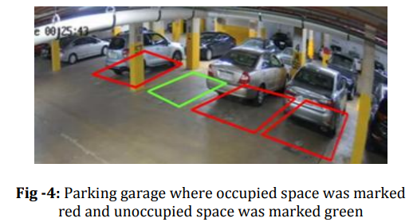
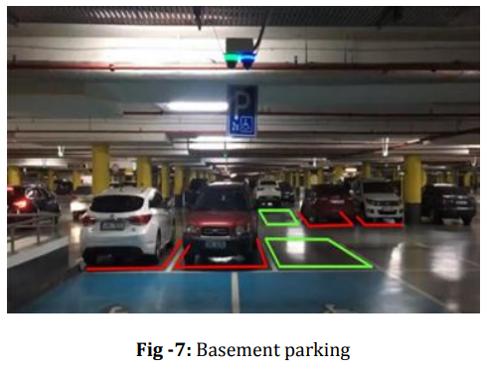
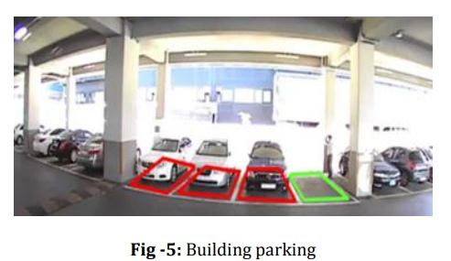
School of Computing Science & Engineering
Course Name :Project-2
IMPLEMENTATION
Running the program, the Empty slot detection system has been exact in demonstrating
whether a parking spot is occupied or not.
Figures 4 and 5 show the condition of the parking structure and the building, masked with colored rectangles.
Program Name: B-TECH CSE Sem: IV

Slide 12
School of Computing Science & Engineering
Course Name :Project-2
Chapter-4:
Result and Conclusion:
Image Processing is very crucial for extracting any information from an image. In this study, a proposed plan for a smart parking system based on image processing has been effectively tried and run with a few videos taken from indoor parking garages. The system works precisely in deciding regardless of whether the parking slots are occupied or not by showing a red outline if a vehicle is inside or consuming a parking spot and afterward turns green when it is unoccupied. In the number plate detection, we first applied image processing algorithms to images and afterward those images were utilized in Tesseract software to acquire the text from the images. Different images have distinctive text styles, length, width and font, so different images require different levels of digital image processing techniques. Out of these image results for a single image the most appropriate image is then applied to Tesseract for obtaining the text from an image. Therefore, after digitally processing the image we have accomplished better and near to perfection outputs.
The proposed system accurately detected the presence of cars in parking slots. The filled image approach performed better than the use of dilated edge images to determine vacancy of parking spots. The two approaches could be fused into one system. The camera position could be adjusted to improve the performance. From the above set of test results, it has been shown that the proposed imageprocessing-based system is a viable option for parking space vacancy management. Other technologies such as automatic number plate recognition and traffic light control could be conjoined with this system to form holistic intelligent transport systems.
Program Name: B-TECH CSE Sem: IV

Slide 13
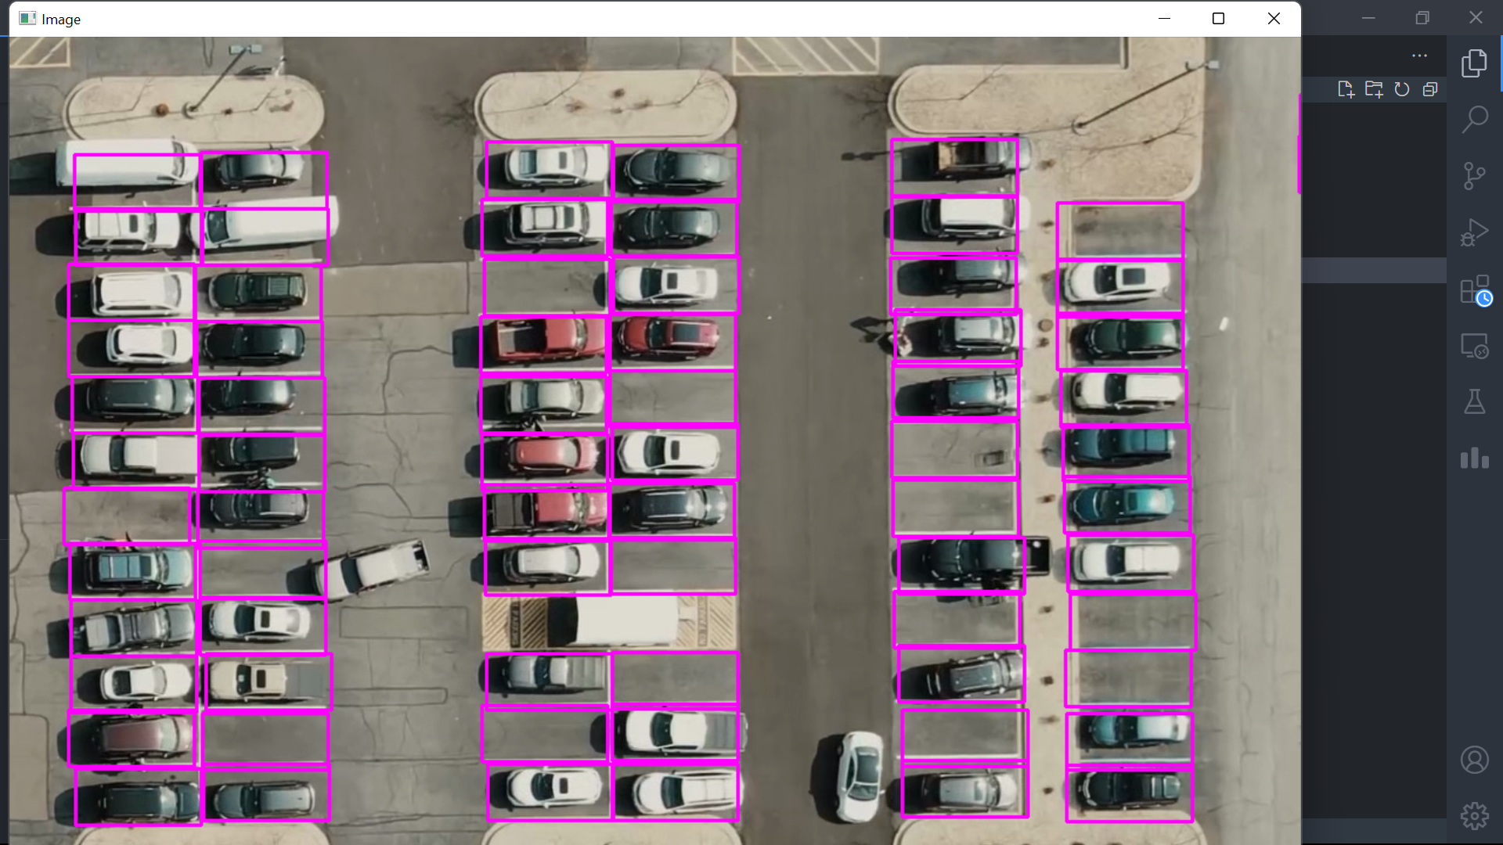
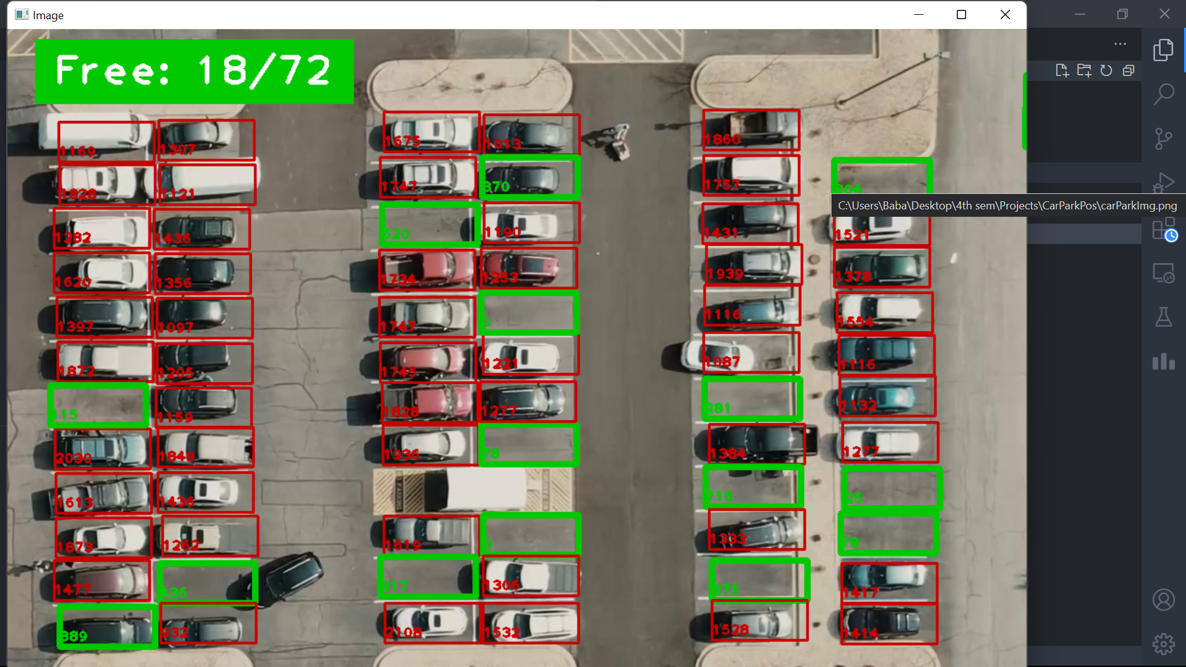
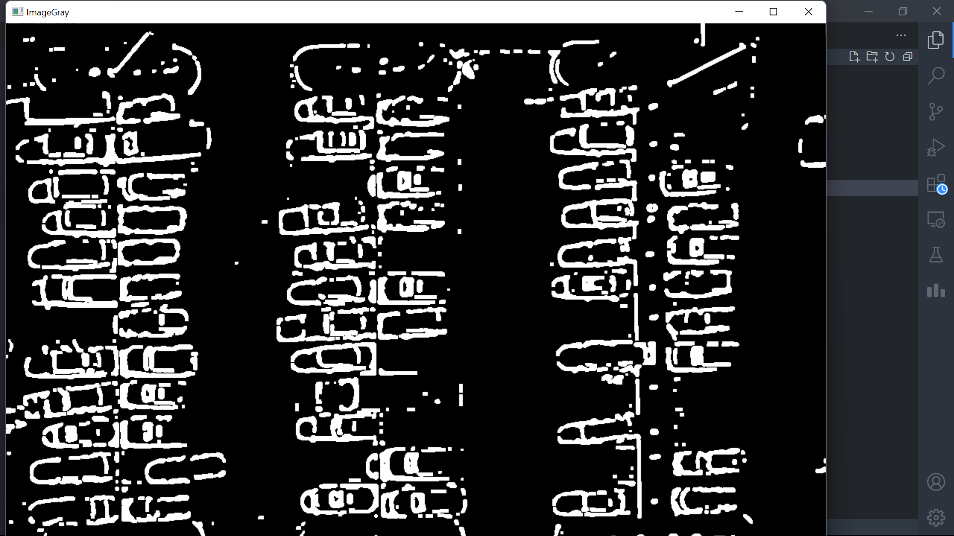
School of Computing Science & Engineering
Course Name :Project-2
RESULTS FROM CODE
Program Name: B-TECH CSE Sem: IV

Slide 14
School of Computing Science & Engineering
Course Name :Project-2
References:
[1] Ming-Yee Chiu; Depommier, R.; Spindler, T.; , "An embedded realtime vision system for 24- hour indoor/outdoor car-counting applications," Pattern Recognition, 2004.
[2] Zhang Bin; Jiang Dalin; Wang Fang; Wan Tingting; , "A design of parking space detector based on video image," Electronic Measurement & Instruments, 2009.
[3] F. Zhou, and Q. Li, “Parking guidance system based on ZigBee and geomagnetic sensor technology,” 13th International Symposium on Distributed Computing and Applications to Business Engineering and Science (DCABES) 2014, pp. 268-271.
[4] Y. Zheng, S. Rajasegarar, and C. Leckie, “Parking availability prediction for sensor-enabled car parks in smart cities,” IEEE 10th International Conference on Intelligent Sensors Sensor Networks and Information Processing (ISSNIP) 2015, pp. 1-6.
[5] A. Khanna, and R. Anand, “IoT based smart parking system,” 2016 International Conference on Internet-ofThings and Applications (IOTA), Pune, 2016, pp. 266-270.
[6] Z. Ji, I. Ganchev, M. O'droma, and X. Zhang, “A cloud-based intelligent car parking services for smart cities,” General Assembly and Scientific Symposium (URSI GASS) 2014 XXXIth URSI, pp. 1- 4.
[7] K. Cheng, “Indoor Parking DAHUA,” 2018. [Online]. Available: https://www.youtube.com [Accessed 2018].
[8] KETOSI, “[KETOSI] Audi R8 V10 Parking Lot Accident CCTV,” 2013. [Online]. Available: https://www.youtube.com [Accessed 2018].
Program Name: B-TECH CSE Sem: IV

